Slide 1
Programming fundamentals lab
Course code: CS118
Credit hours: 1

Slide 2
Introduction
Lecturer: Ms. Saba Ghani
Department of Computer Science
MSCS-FAST NUCES
BSCS-LCWU Lahore
Email: saba.ghani@nu.edu.pk

Slide 3
Course Format
Lab is practical in nature with heavy reliance on daily lab tasks
Alternative lectures will be followed by a graded assignment
Assignments will be both individual as well as group
Quizzes will be announced and unannounced
There will be a project at the end of the semester (done in a group of 2 students)

Slide 4
Attendance Policy
Minimum attendance required to sit in final exam is 80%
No tolerance in this limit will be offered
Proxy attendance will result in marking of absence for both the students for 3 lectures

Slide 5
Honor Code
Dishonesty will NOT be tolerated
Will result in zero marks in the corresponding work
All parties involved in any kind of cheating (in any exam) will get a zero (in that exam)

Slide 6
General Guidelines
Visit slate course folder regularly for updates
Start working on projects/assignments right from the first day and submit your lab tasks before deadline
Come prepared in the class
Do not hesitate. Ask questions freely (Raise hand and wait for your turn)

Slide 7
Today’s agenda
Algorithms
Pseudo codes
Applications
Basic operations
Rules
Flow charts
Symbols
Types
guidelines

Slide 8
algorithm
A list of instructions specifying a precise description of a step by step process to solve a specific problem
Properties of an algorithm:
Finiteness: exact number of steps of steps to be taken
Absence of ambiguity: every instruction is precisely described
Sequence of execution: instructions are performed from top to bottom
Input and output: explicitly define the input and expected output
Effectiveness: solution is guaranteed to give a correct answer or to faithfully carried out
Scope definition: applies to a specific problem or class of problem
Two methods to design an algorithm
Pseudo code
flowchart

Slide 9
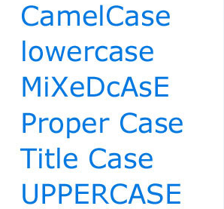
Pseudo codes
The first thing to do while designing a solution for a problem is to decide a name for that particular problem’s solution
Should be problem/solution oriented
Popular naming convention in computer science
CamelCase or dromedary case
First letter of each word in a compound word is capitalized
Most often used in programming languages and website names
Why CamelCase?

Slide 10
Pseudo codes (cont’d)
An informal guide, a tool for thinking through program problems and a communication option that can help you explain your ideas to other people
A step-by-step written outline of your code
Can gradually transcribe into the programming language
Useful for:
To describe how an algorithm should work
To explain a computing process to less-technical users
To design code in a group setting

Slide 11
Writing pseudo code Basic computer operations
Six basic computer operations
Computer can receive information
Computer can output information
Computer can perform arithmetic
Computer can assign a value to a variable or memory location
Computer can compare two variables and select one of two alternate actions
Computer can repeat a group of actions

Slide 12
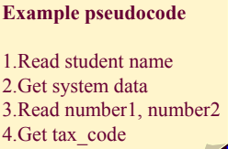
1. computer can receive information
When a computer is required to receive information or input from a particular source, whether it is a terminal, a disk or any other device, the verbs Read and Get are used in pseudocode
Read: Input from a record
Get: Input from keyboard

Slide 13
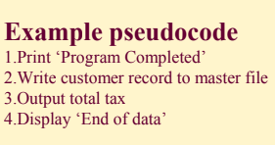
2. computer can output information
When a computer is required to supply information or output to a device, the verbs
Print, Write, Put, Output, or Display are used in pseudocode
Print: send output to printer
Write: send out to file
Put, Output, Display: send to screen

Slide 14
3. computer can perform arithmetic
Most programs require the computer to perform some sort of mathematical calculation, or formula, and for these, a programmer may use either actual mathematical symbols or the words for those symbols
To be consistent with high-level programming languages, the following symbols can be written in pseudocode:
+ for Add - for Subtract * for Multiply / for Divide ( ) for Parentheses
When writing mathematical calculations for the computer, standard mathematical ‘order of operations’ applies to pseudocode and most computer languages

Slide 15
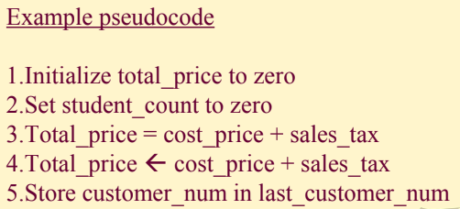
4. computer can assign a value to a variable or memory location
There are three cases where you may write pseudocode to assign a value to a variable or memory location:
To give data an initial value in pseudocode, the verbs Initialize or Set are used
To assign a value as a result of some processing the symbols ‘=‘ or ‘←’ are written
To keep a variable for later use, the verbs Save or Store are used

Slide 16
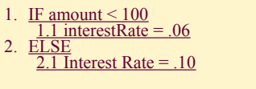
5. computer can compare two variables
A computer can compare two variables and select one or two alternate actions
An important computer operation available to the programmer is the ability to compare two variables and then, as a result of the comparison, select one of two alternate actions
To represent this operation in pseudocode, special keywords are used: IF and ELSE

Slide 17
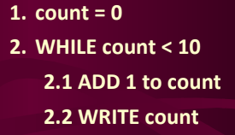
6. computer can repeat a group of actions
When there is a sequence of processing steps that need to be repeated, a special keyword, WHILE is used in pseudocode
The condition for the repetition of a group of actions is established in the WHILE clause, and the actions to be repeated are listed beneath it

Slide 18
Rules for Pseudocode
Write only one statement per line
Each statement in pseudocode should express just one action for the computer
Capitalize initial keyword
READ, WRITE, IF, ELSE, ENDIF, WHILE, ENDWHILE
Keep statements language independent
Indent to show hierarchy
End multiline structures

Slide 19
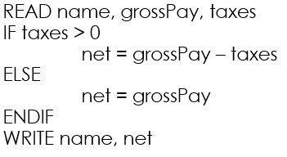
Rules for Pseudocode (cont’d)
Indent to show hierarchy
Each design structure uses a particular indentation pattern
Sequence:
Keep statements in sequence all starting in the same column
Selection:
Indent statements that fall inside selection structure, but not the keywords that form the selection
Loop:
Indent statements that fall inside the loop but not keywords that form the loop

Slide 20
Rules for Pseudocode (cont’d)
End Multiline Structures
See the IF/ELSE/ENDIF as constructed above, the ENDIF is in line with the IF
The same applies for WHILE/ENDWHILE etc...

Slide 21
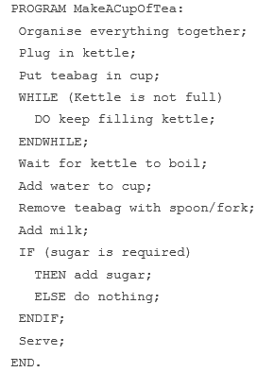
Pseudo code practice question:1
Write down a pseudo code for making a cup of tea
5 minutes

Slide 22
practice question:2
Consider the problem of searching for an entry in a phone book with only condition:
GET first entry
IF this is the required entry
Then write down phone number
ELSE get next entry
IF this is the correct entry
then write done entry
ELSE get next entry
if this is the correct entry
…………….

Slide 23
Cont’d…
This could take forever to specify
There must be a better way to do it
Write down solution
10 minutes
GET first entry;
Call this entry N;
WHILE N is NOT the required entry
DO Get next entry;
Call this entry N;
ENDWHILE;

Slide 24
flowchart
Represents an algorithm in graphical symbols
Flowchart shows the steps as boxes of various types and their order by connecting the boxes with arrows
Four general types
Document flowcharts: showing controls over a document-flow through a system
Data flowcharts: showing controls over a data-flow in a system
System flowcharts: showing controls at a physical or resource level
Program flowchart: showing the controls in a program within a system
Flowchart software
Microsoft Visio
Edraw Max
SmartDraw

Slide 25
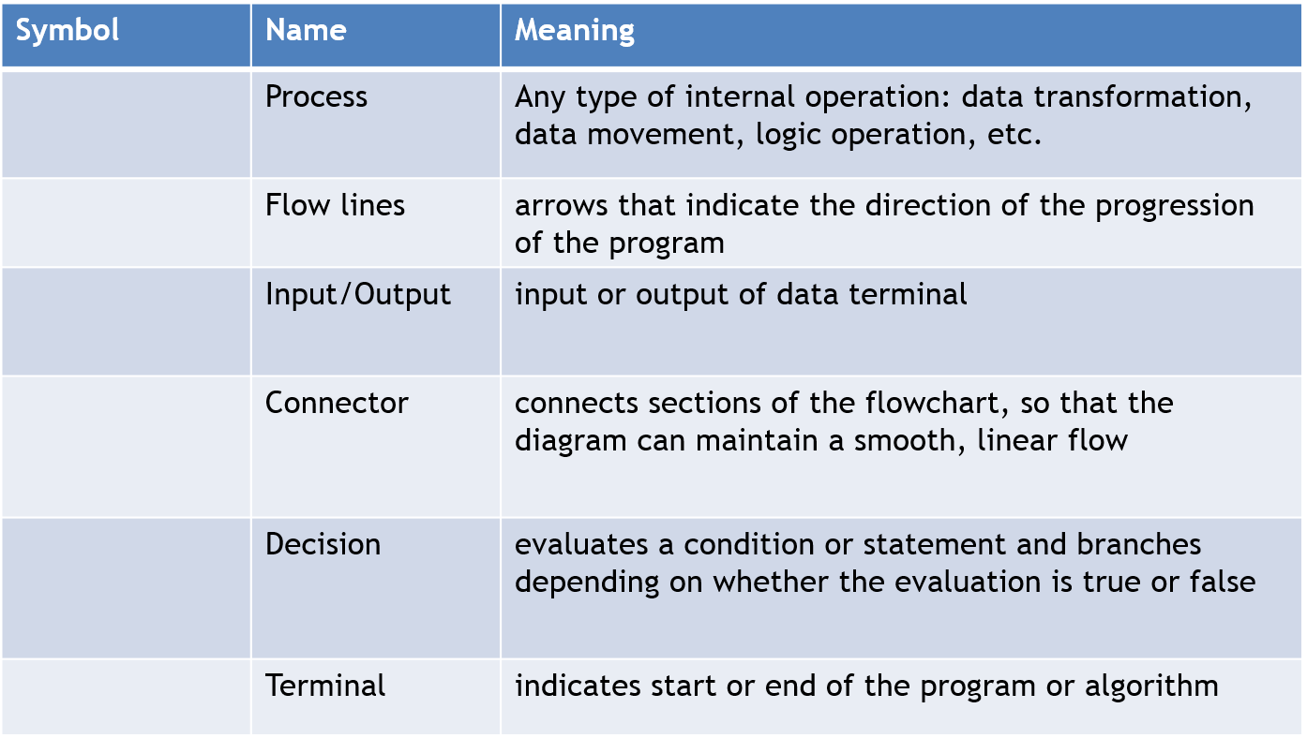
Flowchart symbols

Slide 26
Flowchart guidelines
Flowchart should flow from top to bottom
An upward flow can be shown as long as it does not exceed 3 symbols
If the chart becomes complex, utilize connecting blocks
From one page to another page
From the bottom of the page to the top of same page
An upward flow of more than 3 symbols
Avoid intersecting flow lines
Use meaningful description in the symbol

Slide 27
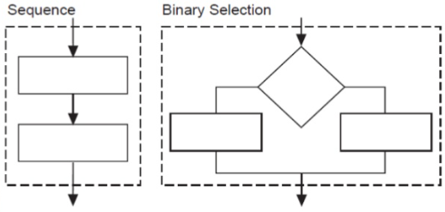
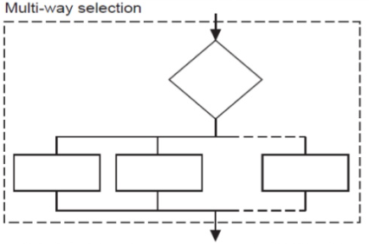
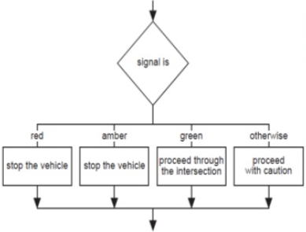
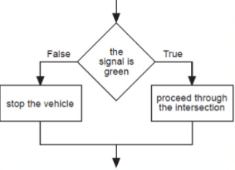
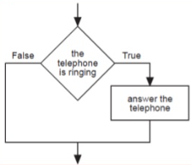
Flowchart types

Slide 28
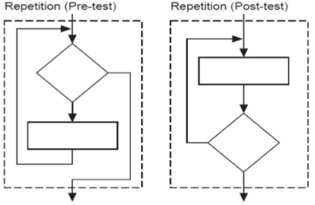
Flowchart types (cont’d)

Slide 29
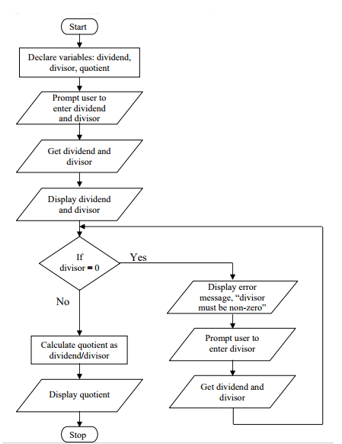
Example
Express an algorithm to get two numbers from the user (dividend and divisor),
Testing to make sure that the divisor number is not zero, and displaying their quotient using a flowchart.

Slide 30
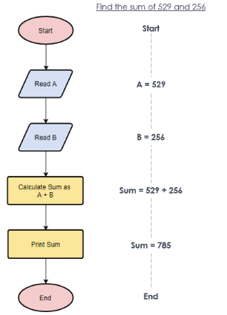
Flowchart practice question:1
Find the sum of 529 and 256
7 minutes

Slide 31
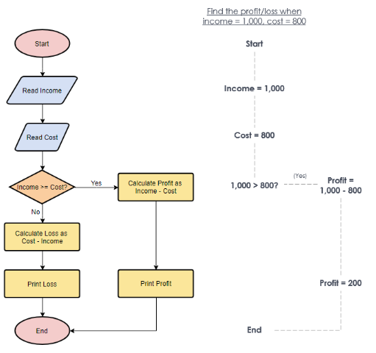
Flowchart practice question: 2
Find profit/loss when income=1,000 and cost=800
10 minutes

Slide 32


